Slide 1
Neural Variational Learning for Grounded Language Acquisition
Nisha Pillai (npillai1@umbc.edu)
Cynthia Matuszek (cmat@umbc.edu)
Francis Ferraro (ferraro@umbc.edu)
Interactive Robotics and Language Lab
University of Maryland, Baltimore County

Slide 2
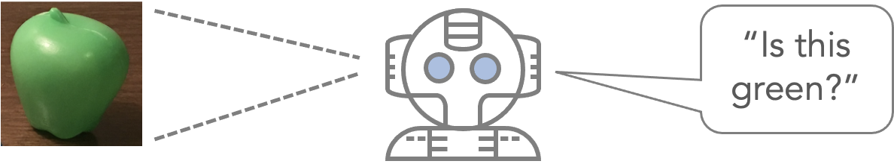
Concept Grounding Problem
Concept Grounding: Ability to understand “concepts”
  Specific attributes, object type, shape
  Fixed set high-level categories
Goal: Generalize language acquisition by moving away from predefined categories
  General classifiers

Slide 3
Attribute Concepts ⟷ Visual Percepts
Category-free language model using the comprehension of visual features to enhance grounded language acquisition in limited resource settings, with no pre-trained image models necessary

Slide 4
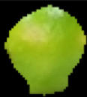
Approach
Previous Approach
c_{green-COLOR}
“This is a sour fruit”
Grounded language concept
learning
✓
c_{green-SHAPE}
×
Our Approach: Unified Discriminative Model
Grounded language concept
learning
Unified Neural Learning
c_{GREEN}
“This is a sour fruit”
✓

Slide 5
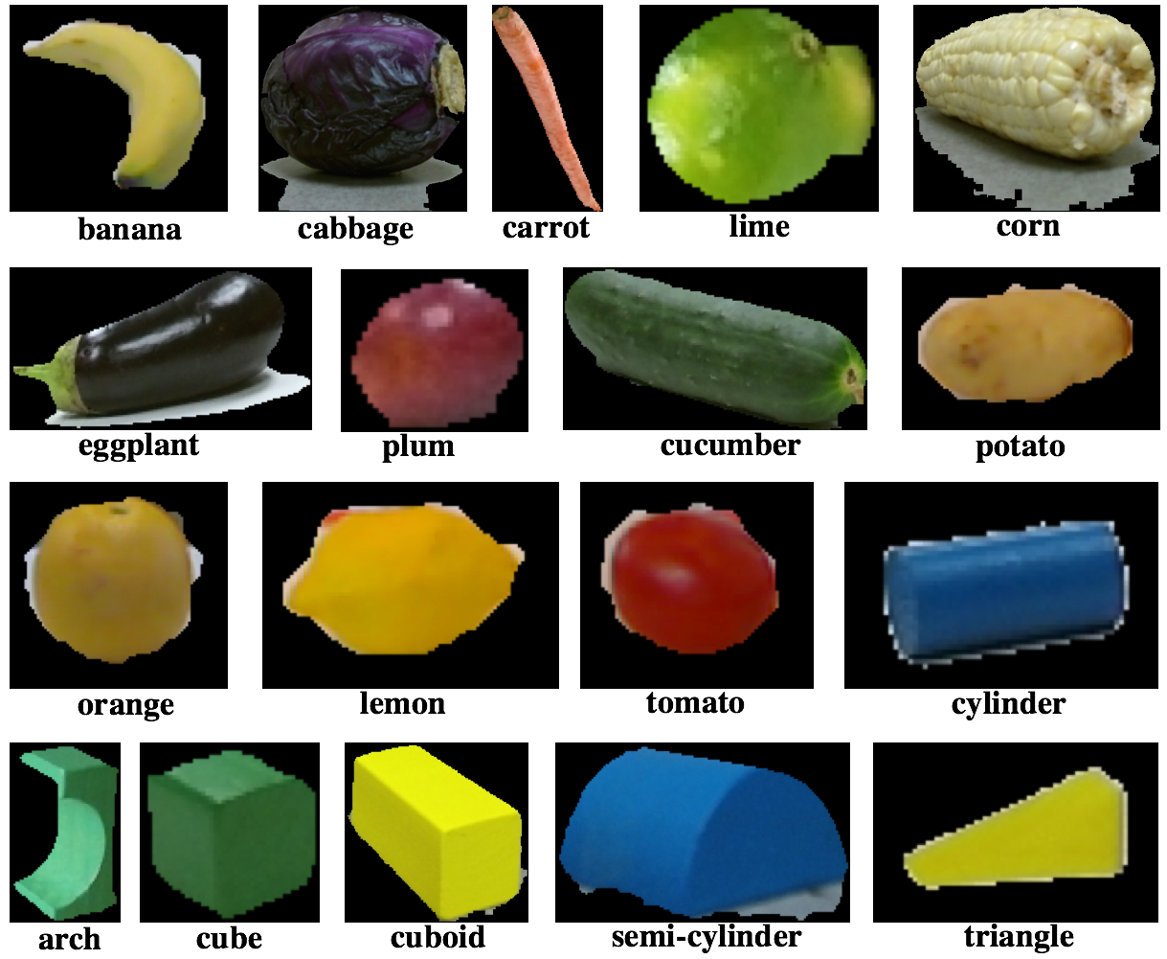
Data Corpora
UMBC^{[1,2]}
  72 object, 18 categories
  Language:
    6000 English
    5100 Spanish
    5700 Hindi
UW RGB-D+^{[3]}
  300 instances
  51 categories
  1500 English
descriptions^{[4]}
    [1] UMBC English: Pillai et al. AAAI 2018
    [2] UMBC Spanish and Hindi: Kery et al. Ro-Man 2019
    [3] UW RGB-D+ Visual Objects: Lai et al. Consumer Depth Cameras for Computer Vision 2013
    [4] UW/UMBC RGB-D + Language: Richards et al, ICRA 2019

Slide 6



Descriptions
Image | Description
 | The picture looks like a yellow semi-circle. This is a half yellow cylinder. This is a lemon wedge.
 | This is a beefsteak tomato. This is a red tomatoe. This is a tomato. A tomatos is a fruit, not a vegetable. The tomato is color red. You can mix this in salads.
 | This is a green colored building block with a half pipe cut out of it. This is a block. The block is color green. The block is shaped like a tape dispenser. The background is black.

Slide 7

Unified Discriminative Model
Initial Visual
Feature Extraction
Latent Feature Discriminative Model
Unsupervised
grounded concept learning
v_{enc}
v_{dec}
“This is a sour fruit”
Unsupervised
grounded concept evaluation
c_{green}
v_{enc}
✓
c_{carrot}
×

Slide 8
Visual classification
Visual features: RGB-D and CNN
  Kernel descriptors
  SmallVGGNet, NasNetLarge
UDM structure
  VAE: MLP with single hidden layer
  Latent Embedding: 12, 50, 100
Linguistic concepts from descriptions

Slide 9
Comparisons
 | Predefined Category classifier
Minimum | 0.2460
Mean | 0.7062
Median | 0.7240
Maximum | 0.9560
Category-free Logistic Regression
0.2330
0.6078
0.6510
0.8880
Unified Discriminative Method
Dim 12 | Dim 50 | Dim 100
0.2570 | 0.4560 | 0.2420
0.6590 | 0.7137 | 0.6342
0.6510 | 0.6990 | 0.6430
0.9680 | 0.9630 | 0.9000
Higher quality learning of UDM for underperformed classifiers
  Higher mean, minimum, maximum
Worst classification
  Baselines: classifier banana
  UDM: classifier Green

Slide 10
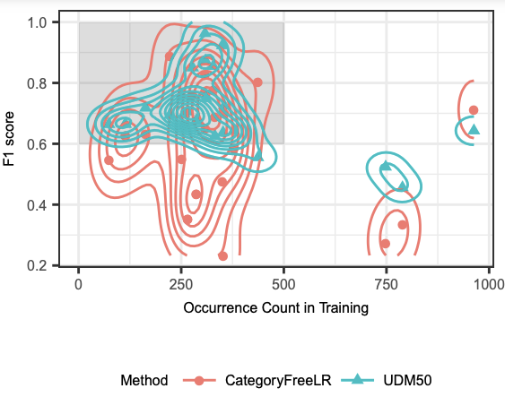
Limited Resource Tests
UMBC object set evaluations
Goal: high f1-score with a smaller number of occurrences
UDM performance is consistent and high with limited annotation

Slide 11
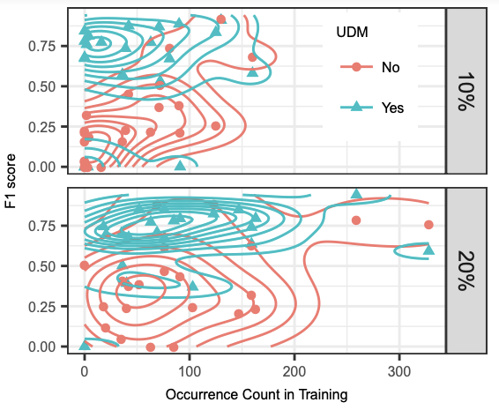
Efficacy over CNN models
SmallVggNet CNN model Vs. UDM
Limited resources
UDM: High and consistent learning
  Upper quadrant

Slide 12
Multi-Lingual Verifications
Language | Sampling | 10% | 20% | 30% | 40% | 50% | 60% | 70%
Spanish | Category-Free LR | 0.05 | 0.14 | 0.23 | 0.41 | 0.43 | 0.49 | 0.48
 | UDM | 0.14 | 0.24 | 0.32 | 0.45 | 0.45 | 0.48 | 0.52
Hindi | Category-Free LR | 0.038 | 0.160 | 0.228 | 0.334 | 0.437 | 0.504 | 0.518
 | UDM | 0.187 | 0.290 | 0.413 | 0.490 | 0.516 | 0.536 | 0.552
Varied, diverse, and noisy dataset
UDM achieves consistent performance improvements

Slide 13
Conclusion
Simple, strong approach for unified language grounding
Language acquisition without predefined categories
Acquisition improvement with limited resources
Successful learning of broad range of concepts.
  Gaussian variational autoencoder
  representative features

