Slide 1

Measuring Perceptual and Linguistic Complexity in Multilingual
Grounded Language Data
Nisha Pillai (npillai1@umbc.edu)
Cynthia Matuszek (cmat@umbc.edu)
Francis Ferraro (ferraro@umbc.edu)
Interactive Robotics and Language Lab
University of Maryland, Baltimore County
National Science Foundation Grant Nos. 1657469, 1940931, and 2024878

Slide 2
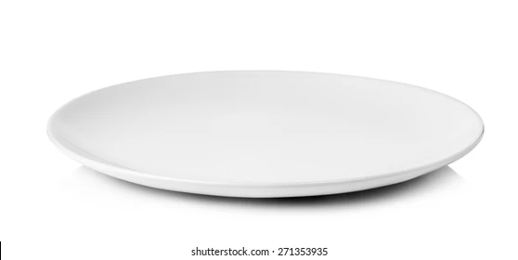

Slide 3
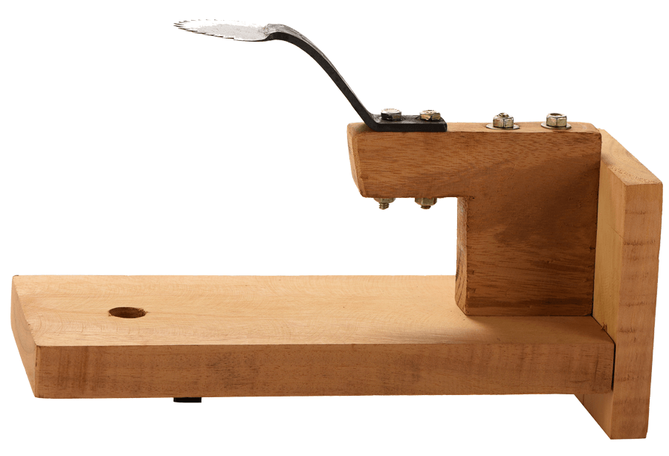

Slide 4
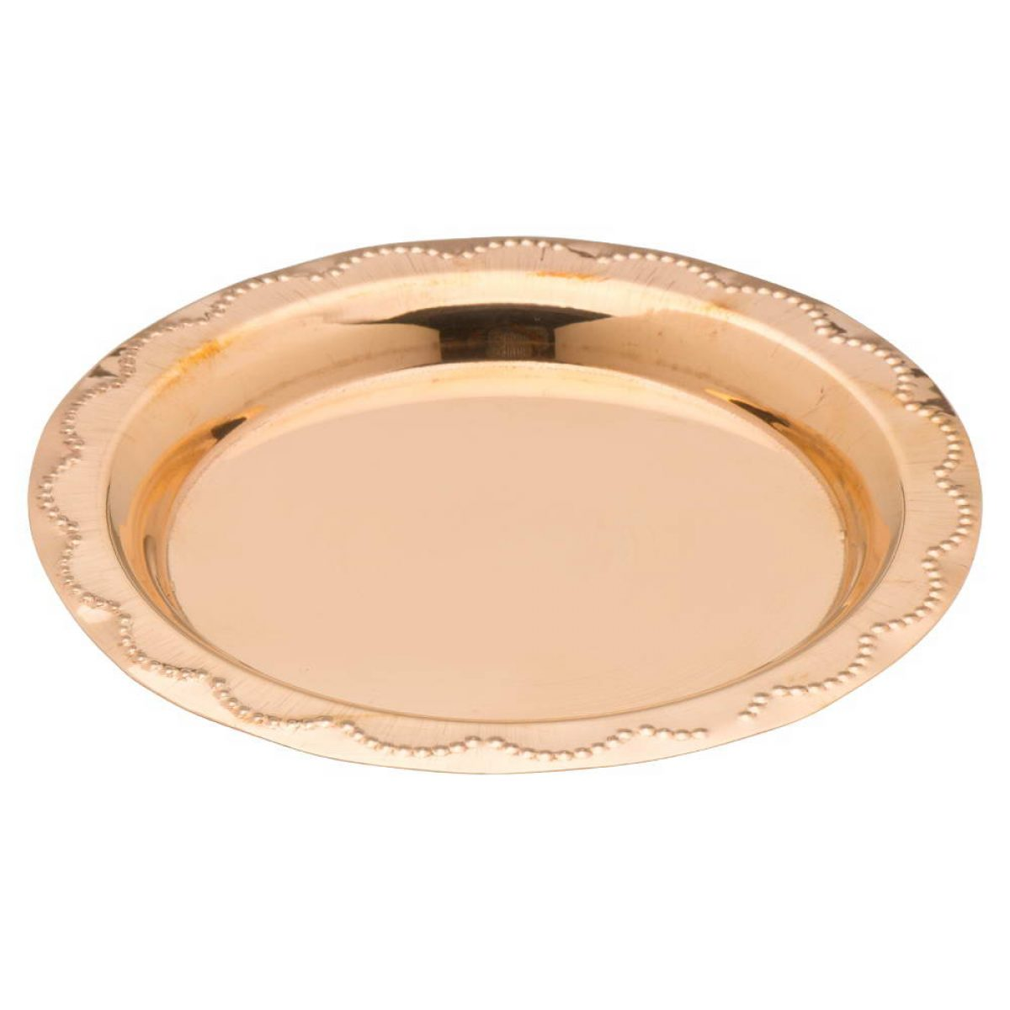
Visual and linguistic complexity
c
Which object is difficult to learn?
  Intuitive concepts for humans
Which one is more visually complex?
  Difficult to verbalize or define
Which one is easier to describe?

Slide 5
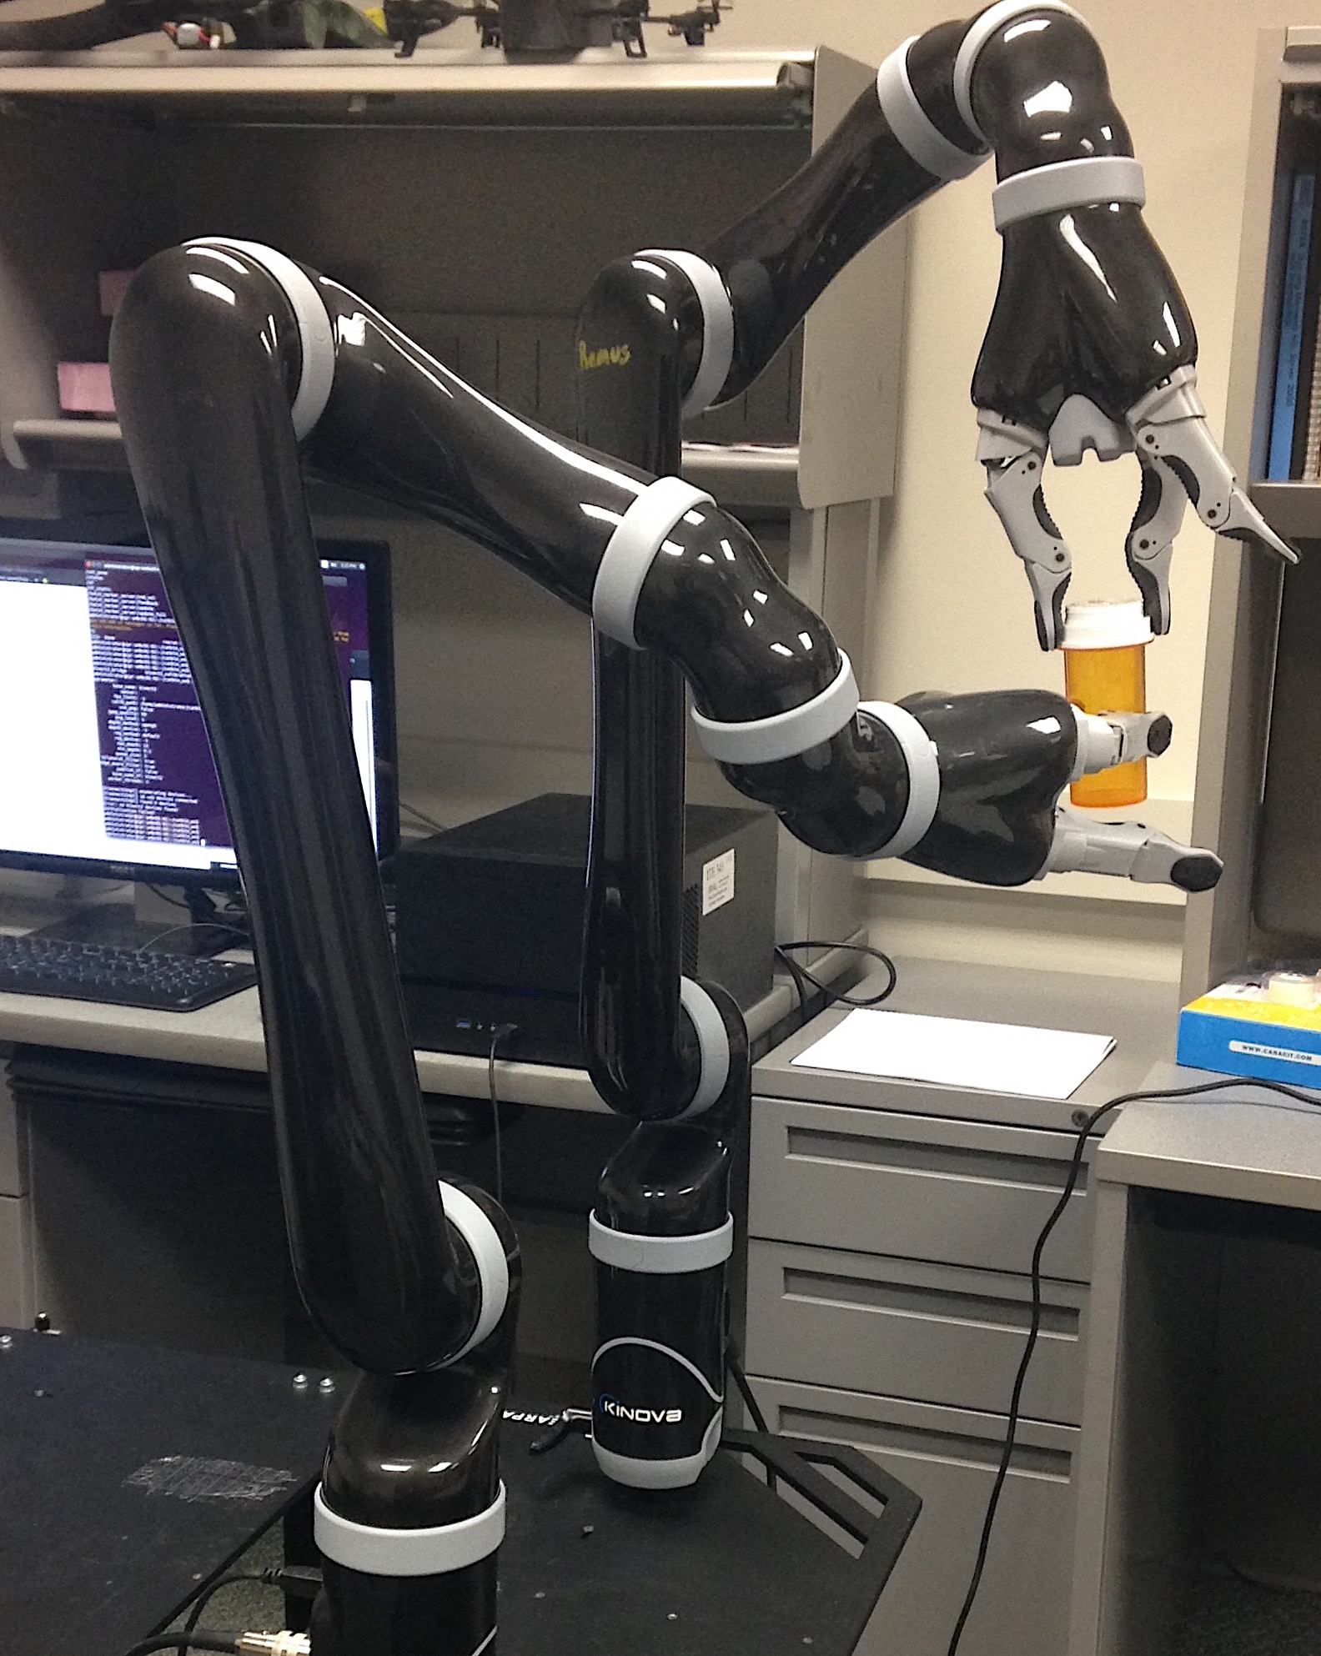
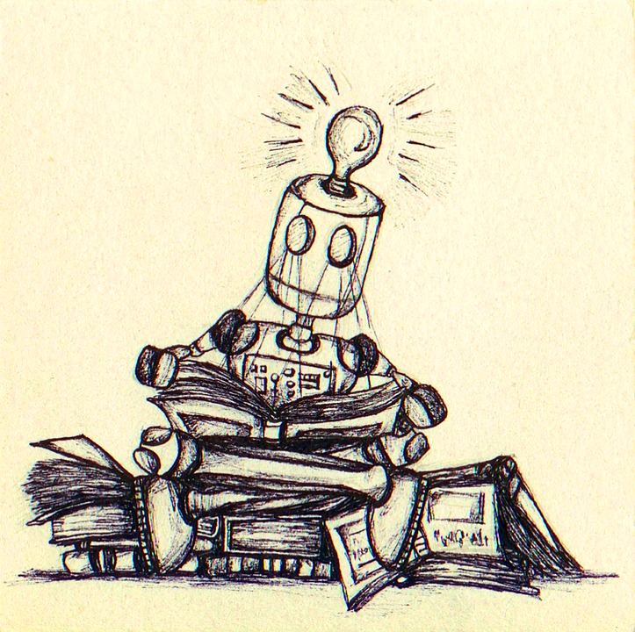
Robotic Language Acquisition
Learn language by interacting with people and world
  Smooth interaction with untrained users: language
  Natural, intuitive, useful
Make ubiquitous robots
  Capable and useful
  Interpret and execute
non-specialist input
Learn about world and
tasks from users
Notes:
The development of an intelligent robot with which people would embrace a long-term interaction is one of the major challenges in the research field of robotics. To achieve actual long-term communication and collaboration between a human and a robot, the robot has to understand the meanings of utterances, learn new vocabularies, and create a comfortable learning environment with people in the real world.To make a robot capable and useful, it has to interpret and execute the tasks and has to perform tasks assigned by the human. Grounded language acquisition is the task that learns language by interacting with people and the world. My research is focussed on how robot learns the language.

Slide 6
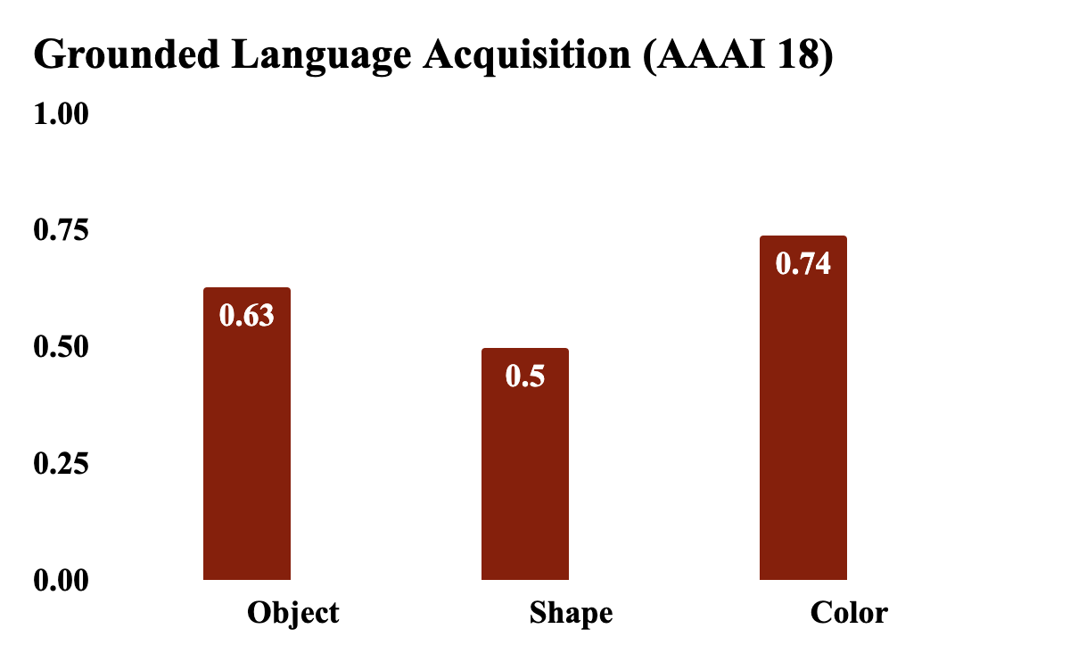
Prior Research
Task: Learn semantic representation of perceived environments.
Color: Good classification
results. Overlapping
descriptions.
Shape: Difficult to learn. Varied shapes and noisy annotations.
Object: Better results than shape.

Slide 7
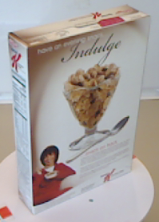

Visual complexity?
Which one is more visually complex?
  Difficult to verbalize or define
Smoothness, color simplicity, multi-part...

Slide 8


Linguistic Complexity?
“cube, red block”
“three dimensional red object”
“This is a building block with a half-pipe cut out of it”
“The block is shaped like a tape dispenser”
Which one is more linguistically complex?
How do we measure it?

Slide 9
Contributions
Can we effectively measure the complexities in learning different traits involved in grounded language acquisition?
Trait-based complexity for multi-modal, multi-lingual sensor inputs.
Identify appropriate metrics and statistical tools.
  Measure perceptual and linguistic variety.

Slide 10
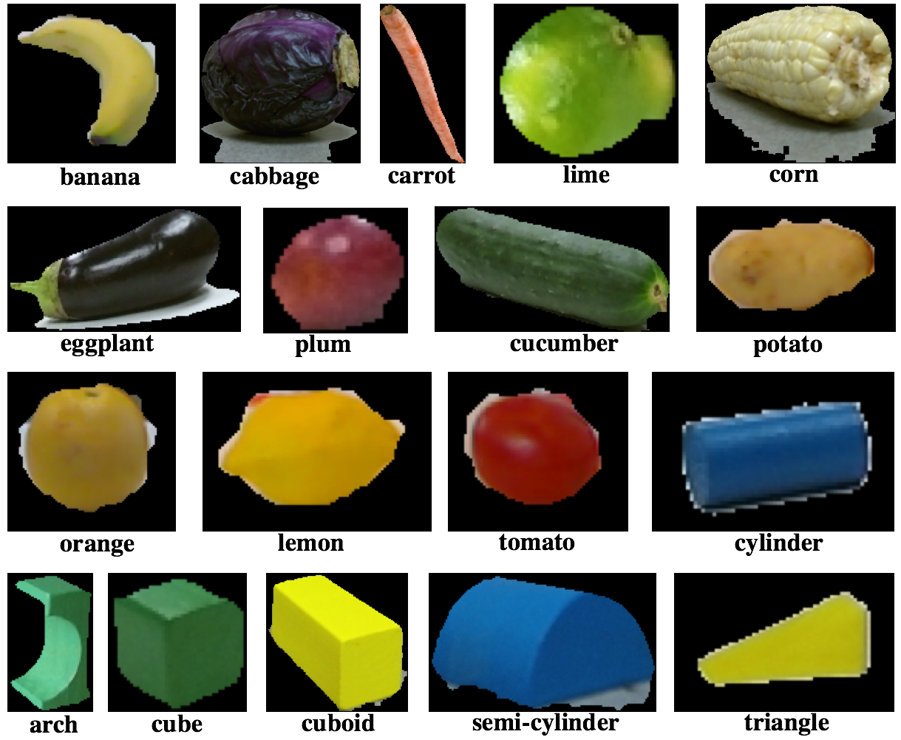
Data Corpora
UMBC^{[1,2]}
  72 object instances
  18 categories
  Language:
    6000 English
    5100 Spanish
    5700 Hindi
UW RGB-D+^{[3]}
  300 instances
  51 categories
  Language:
    1500 English descriptions^{[4]}
    [1] UMBC English: Pillai et al. AAAI 2018.
    [2] UMBC Spanish and Hindi: Kery et al. Ro-Man 2019
    [3] UW RGB-D+ Visual Objects: Lai et al. Consumer Depth Cameras for Computer Vision 2013.
    [4] UW/UMBC RGB-D + Language: Richards et al, ICRA 2019.

Slide 11
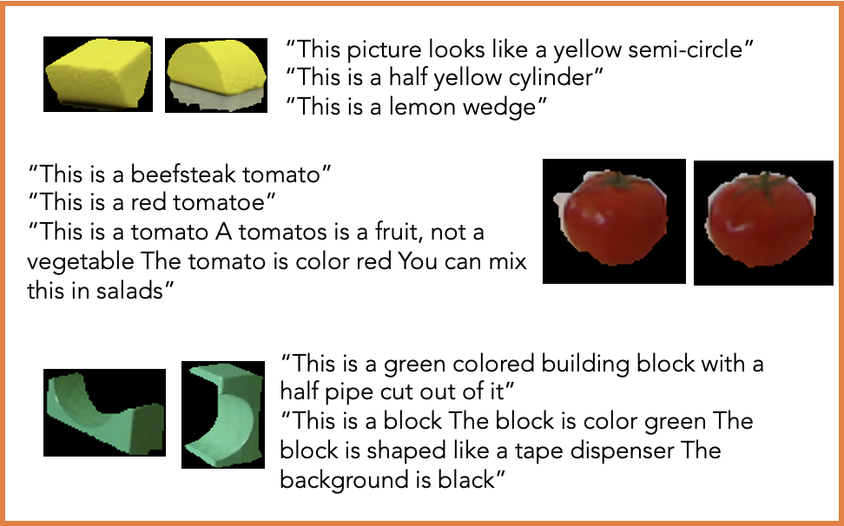
Learning Tasks & Intuitions
 | Color | Shape | Object type
Visually | Simple | Complex | Complex
Linguistically | Simple | Varied | Consistent

Slide 12
Approach
Demystify and quantify multi-modal complexities.
  Analyze and understand data and learning problem
Language: Sentence based entropy analysis
Visual characteristics
Color: Standard deviations
Shape: Image compression based metrics

Slide 13
Linguistic Complexity
Lexical entropy based metric
Frequency of every concept, v in d_{i}
p_{i,v} ∝ count(v ∈ d_{i})
d_{i} : All descriptions of an instance
Entropy h_{i} of an instance
h_{i} = –∑_{u} p_{i,u} log p_{i,u}
Entropy h_{c} of a concept, ∑_{j} h_{j}
Combine all entropies of concepts belonging to a trait: color, shape, and object

Slide 14
Visual Complexity
Edge density measures and compression errors^{[5]}
For color: Standard deviation of RGB values
For shape: JPEG compression loss
HSV values from RGB images
Edge detection using canny
  Multi-stage algorithm detects edges in images
Estimate JPEG compression error
[5] Machado. et. al, 2015

Slide 15
Analysis & Intuitions
Dataset
Lang.
Color
Shape
Object Type
UMBC
English.
Concise, less varied
Contrasting, 83.3% of instances with shape concepts
Varied and diverse descriptions
Spanish
Concise, less varied
Various concepts of similar meaning
Varied and diverse descriptions
Hindi
Semantically similar, gender based inflectional differences
Highly varied and diverse concepts
Varied and diverse descriptions
UW RGBD+
English.
Multicolor objects, medium consistency in descriptions.
Many concepts with similar meaning, Only 9.5% of all instances have shape concepts
Varied and diverse descriptions

Slide 16
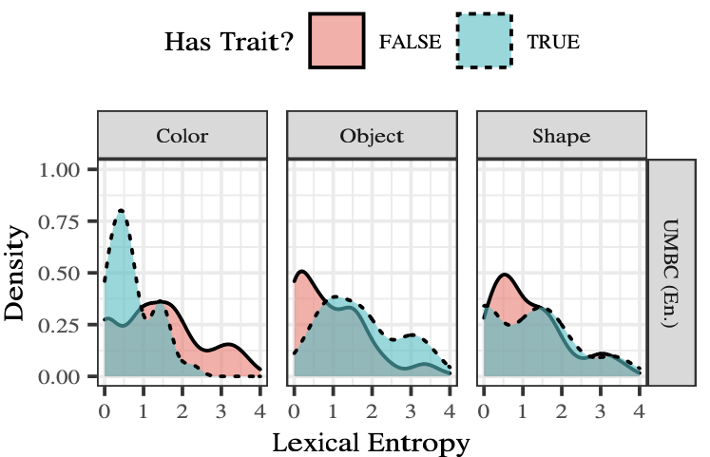
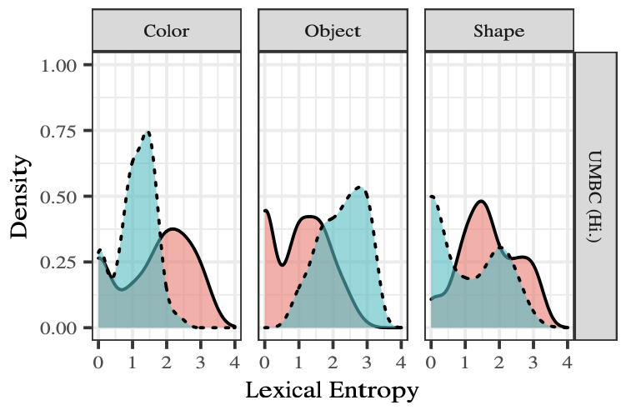
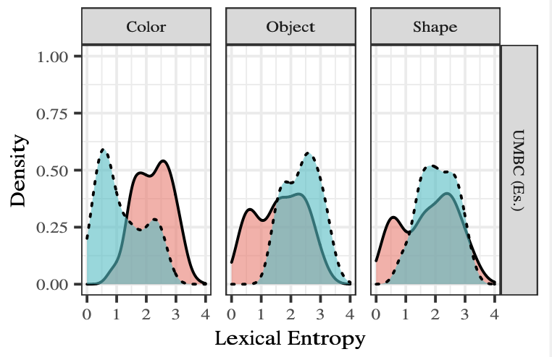
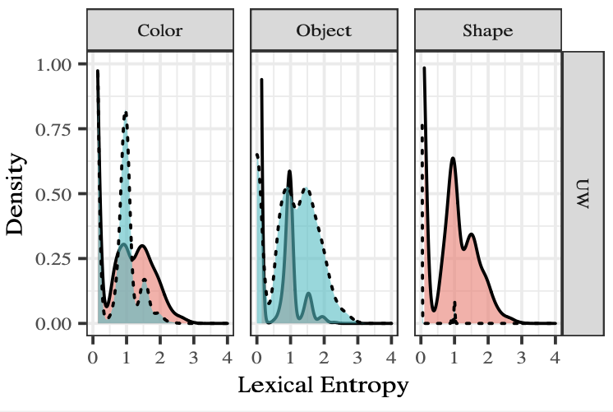
Lexical Complexity Measures
Entropy for color concepts is lower than non-color.
  Concise, less varied vocabulary of colors
Object trait entropy is higher.
  Linguistic variability

Slide 17
Avg. Lang. Complexity
Color is less varied compared to non-color language concepts
Shape and object are complex and varied
  Noisy dataset, diverse and varied annotations
Dataset | Language | Color |  | Shape |  | Object
 |  | Yes | No | Yes | No | Yes | No
UMBC | English | 0.7099 | 1.4247 | 1.1967 | 1.1830 | 1.6724 | 0.9467
 | Spanish | 1.1667 | 2.2269 | 2.0730 | 1.7751 | 2.3808 | 1.6259
 | Hindi | 1.0855 | 1.6095 | 0.9460 | 1.6778 | 2.2731 | 1.0285
UW RGBD+ | English | 0.3854 | 0.5826 | 0.0042 | 0.71003 | 1.0280 | 0.2177

Slide 18
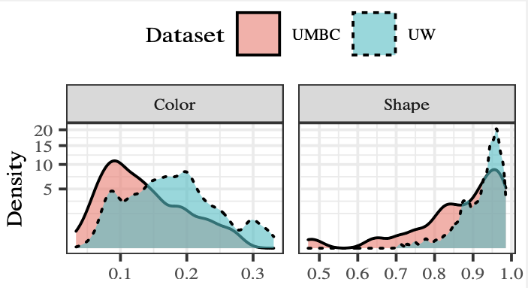
Visual Complexity Measures
Standard Deviation
Compression Error
Lower standard deviation → Visual color consistency
High compression error → highly varied and complex features

Slide 19
Summary
Automated analysis of multilingual grounded language data
Statistical measures for estimating intricacies
Additional tools for analyzing and understanding their data and underlying learning problem
Improved design decisions
  Appropriate feature selection
  Selection of classification model

