Slide 1

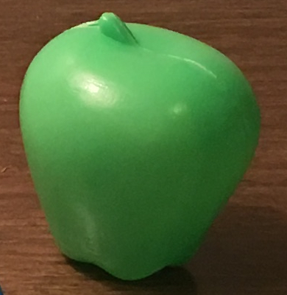


DEEP LEARNING FOR CATEGORY-FREE GROUNDED LANGUAGE ACQUISITION
http://bit.do/beyondtype
“Is this
green?”
Previous Approach…
Our Approach…
”green”-shape-classifier
✗
?
”green”-classifier
✓
”green”-color-classifier
✓
Domain-specific, with preset features
General visual classifiers learned from
unified generative neural model
come see our poster!
Nisha Pillai, Francis Ferraro, and Cynthia Matuszek – { npillai | ferraro | cmat } @umbc.edu
Notes:
The purpose of the system shown here is to ground language in the physical world
It combines depth and color information from sensors with natural language descriptions
In this work, we ask how well this system extends to non-English data? (In this case Spanish)
Given a corpus of crowdsourced Spanish descriptions, we analyze how well the grounding system performed
We also looked at adaptations that might need to be made in the text cleaning and tokenization steps to extract salient tokens
We found that the language grounding system was able to perform comparably with minimal adaptations

