Slide 1

Sampling Approach Matters: Active Learning for Robotic Language Acquisition
Nisha Pillai {npillai1@umbc.edu}
Edward Raff {Raff_Edward@bah.com}
Francis Ferraro {ferraro@umbc.edu}
Cynthia Matuszek {cmat@umbc.edu}
Notes:
Hi, Very good evening. I am Nisha Pillai, a Ph.D. candidate from the University of Maryland, Baltimore County. Here, I am presenting our research titled "Sampling approach matters in Active learning for Robotic Language Acquisition."

Slide 2
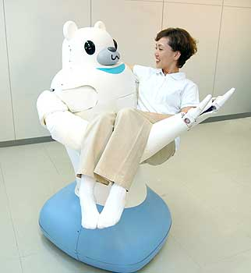
Robotic language acquisition
Smooth interaction with untrained users: language
Make ubiquitous robots capable
  Interpret and execute upon human input
Grounded Language Acquisition
  Learn language by interacting with
people and the world
  High annotation costs
Data is limited in real-world interaction
  Noisy, natural language learning
  Limitation to access big data sources.
Notes:
To be able to work in real-world environments efficiently, robots should interact and communicate with untrained, ordinary people. Robots should be able to interpret and execute the human input. For that purpose, robots should learn the meaning of new concepts associated with visual percepts in such interactive situations. Grounded language acquisition refers to such association of linguistic concepts with the visual percepts.
In real-world environments, data is limited. Access to big data sources with a natural description is limited. Annotation costs are high. And the natural language is often noisy and highly varied. So, research in the direction of grounded language acquisition in a limited resource setting at a low cost is essential.

Slide 3

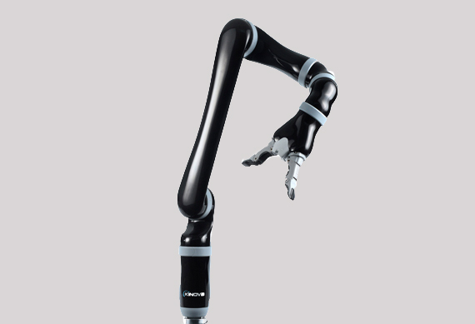
Proposed Endeavor
Efficient robotic language learning system
  System initiated
  Less number of annotation
Active learning (AL)
    Robot actively queries about the world
    Resolve uncertainties
    Minimum manual supervision
    Selection of informative points
Notes:
A large number of annotations or descriptions are required to teach a robot about linguistic concepts and associate them with the highly complex real-world object characteristics. In this research, we are looking for an approach that is system initiated learning in limited-resource settings. Active learning approaches have proven successful in learning the language with low annotation cost. A robot can query the uncertainties about the perception with minimal human supervision and annotation in an active learning scenario. There has been notable research in improving active learning efficiency. To the best of our knowledge, no study has been done to analyse in-depth what active learning approach with which machine learning technique is well suited for learning the language of varying difficulty.

Slide 4

Research Contributions
Broad exploration of the best AL methods.
What methods can reduce the amount of training data?
  non-simulated, real-world sensor data.
Principled analysis of using active learning methods as unsupervised data sampling methods.
Notes:
In this research, we aim to explore the best active learning methods. And what methods are appropriate to reduce the amount of training data required in real-world, noisy environments for language learning. And we aim to examine the best active learning technique with unsupervised methods when no prior data is available to learn.

Slide 5
Approach
Evaluation of different active learning methods
  Pool based and Uncertainty based
Analyze various characteristic grounding quality
  Color, Shape, and Object type
Compare with different visual features.
  Neural based and Non-Neural Based
Different Unsupervised techniques
  Probabilistic clustering
  Point Process modelling
Notes:
Like I mentioned in the previous slide, we explore and analyze a few popular active learning techniques. There are multiple popular approaches; Pool based sampling, stream-based selective sampling, membership query synthesis are some of them. We have selected the most popular methods that use a pool of unlabeled training data and select the points based on certain criteria that can enhance the performance. We explore selecting points that are the most informative, representative, and diverse from the unlabeled pool samples. We also analyze the performance difference in selecting the most certain and most uncertain or confusing data points. We examine the learning quality of object characteristics with varying difficulties, such as color, shape, and object type. CNN based features and traditional visual features are tested to check the efficacy of active learning approaches. We used the probability-based clustering and point process modeling as unsupervised models.

Slide 6
Research Questions
How much does active learning help in limited data settings?
Neural vs Non-Neural methods
Influence of Classifiers
How different characteristics affect the learning performance?
Incorporation of seed language and its effect in learning performance.
Notes:
In this research, primarily, we aim to answer a few research questions. How effective these active learning methods are in noisy, limited-resource settings. Does active learning is efficient both with neural and non-neural visual features? Which classifier might be useful? And how much a change that active learning brings in learning characteristics of objects with different difficulty levels. Finally, we also utilize the information object description along with visual features in unsupervised probabilistic clustering to check if it is efficient.

Slide 7
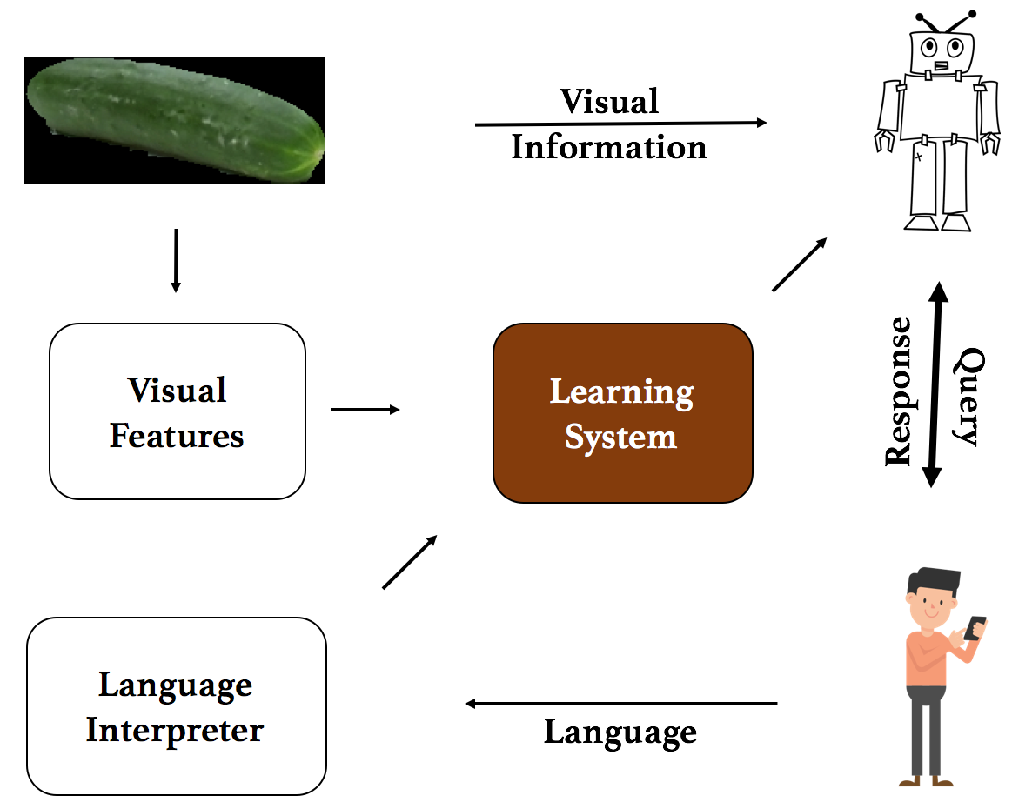
Architecture
Visual Features: color, shape, and object features segmented from depth channel
Visual
Information
Query: Request description
Response: Noisy description
Learning System
Visual
Features
Query
Response
Interpreter: Extract tokens
Language
Interpreter
Learning System: Train on all objects labeled with tokens
Notes:
Here is the overall architecture of our system, where the robot has no prior knowledge. Its job is to learn the semantic representation of the real-world objects it interacts with. The robot uses the visual feature extraction approaches and ranks the objects based on their informativeness or diversity. Then the robot seeks the help of a human it meets to know the description of the selected objects. The description is passed on to the language interpreter, and then the robot learning system associates the interpreted concepts with the visual features of the objects.

Slide 8
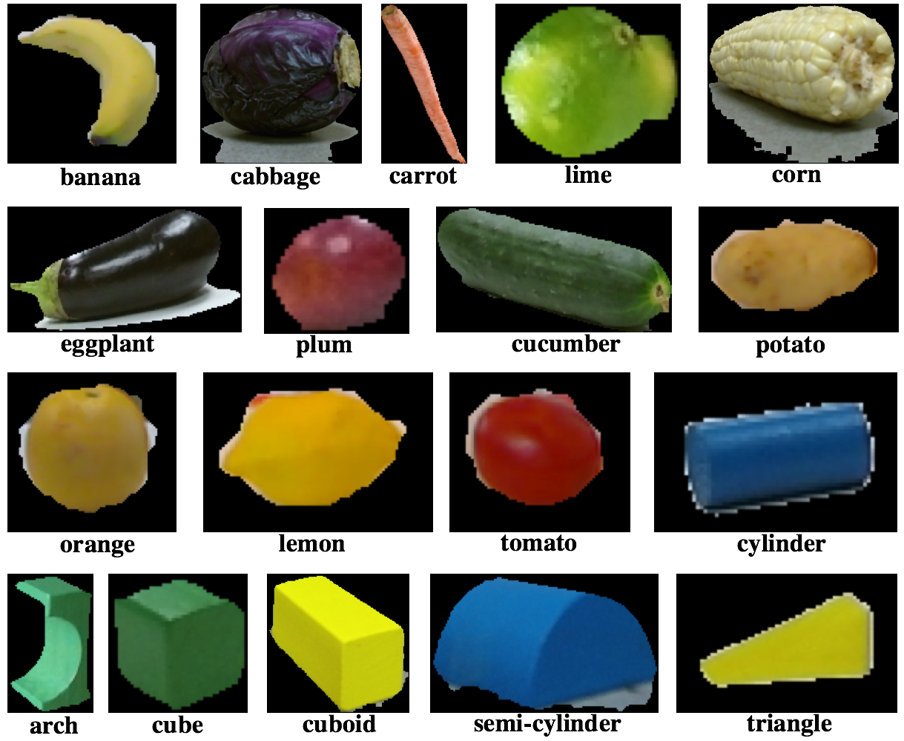
Grounded Corpus
72 instances, 18 categories
  Food objects
  Children’s blocks
  Images from robot sensor
  6 categories from UW rgbdcollection^{[1]}
Descriptive Language:
  6000 descriptions from Mechanical Turk
    [1] Lai, Bo, Ren, Fox. 2013.
Notes:
In our experiments, here are the objects that we utilized. Overall, 72 objects, which are a combination of children's blocks and fruits/vegetables. These are the images from the robot sensor. We had overall 6000 mechanical Turk descriptions for the analysis.

Slide 9


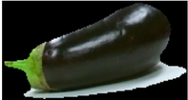
Description Samples
Type | Image | Description
Color |  | This is an orange object.
Shape |  | This looks like a green upside-down C shape.
Object type |  | This is an Italian Eggplant. It is firm and dark purple when ripe.
Notes:
Here are some of the descriptive examples seen in the script. When a carrot is shown, one user described it as an "orange object." Eggplant is mentioned as "Italian eggplant." Some users described it as "brinjal", "eggplanet", etc.. Shape information was seen very less compared to color information in the description. That made shape concept grounding a challenging task.

Slide 10

Max Log-Density-Based GMM Sampling
Cluster and rank unique features according to maximum multi-variate densities.
Selects the most informative points.
(x; 𝝁, ∑) 𝜶 (2𝝅)^{-D/2}|∑|^{-½} exp ^{-½ (X - 𝝁)` ∑` (X - 𝝁)}
^{N K}
Maximize log likelihood, ∑ (log ∑ 𝛼kpk(xi|zk, 𝞱k))
^{i=1 k=1}
Notes:
Here I am introducing one of our active learning strategies that use pool based technique. We use the Gaussian Mixture model probabilistic clustering to calculate the representative points from the samples' unlabeled pool. GMM is a parametric probability model that assumes the data distribution is from a mixture of a finite number of Gaussian distribution shown in the 1st equation. It is parameterized by two kinds of variables; component weights and means/covariances. Expectation maximization for maximum likelihood estimation is used in several iterations to calculate the probability distribution of data points in the execution. Once we have the log densities, we rank them with respect to their closeness to the component means. The points which are near to the centers confirms the certainty, and we rank them in the order of high log density and consider as the most representative points in the pool.

Slide 11
Log-Density-Based GMM Uncertainty
Probabilistic GMM Clustering.
Data points far from the component centres.
Cluster and rank unique features.
Outliers are the most diverse points.
  Variability models the uncertainty.
Notes:
In this approach, Log Density-based GMM Uncertainty sampling, we utilize a data point's uncertainty to belong to any cluster to measure the diversity. This approach's equations are mostly the same as we used the same probabilistic GMM clustering as a machine learning technique. The points which are not near to any component centers are considered outliers. We rank them according to their density and selects them as diverse points.

Slide 12
DPP Sampling
Most diverse points using RBF kernel
Derives a discrete probability function.
P( x | X) = det(K_{X}⁽⁰⁾)/det(K_{X}⁽⁰⁾ + I)
K_{X}⁽⁰⁾ , A positive semi-definite matrix
K⁽¹⁾(x_{i}, x_{j}) = exp (-h || x_{i} – x_{j} ||²₂)
Notes:
The next active learning, DPP sampling, uses deterministic point process modeling. DPPs have proven effective in modeling diversity. We use this technique to filter the most informative and diverse points from the data point set. DPP defines probability distribution functions for all samples using a radial basis function (RBF kernel) with carefully selected parameters. Here are the equations used in the calculation. We set the order of diversity of the unlabeled data samples after several iterations.

Slide 13
GMM - DPP Sampling
Derive DPP Kernel for diversity
Combine DPP Kernel with GMM Marginal probability
P( x | X) = det(K_{X}⁽⁰⁾)/det(K_{X}⁽⁰⁾ + I)
K_{X}⁽⁰⁾ , A positive semi-definite matrix
K⁽¹⁾(x_{i}, x_{j}) = exp (-h || x_{i} – x_{j} ||²₂)
K⁽²⁾(x_{i}, x_{j}) = P_{GMM}(X_{i}) K⁽¹⁾(x_{i}, x_{j}) P_{GMM}(X_{j})
Notes:
Here we introduce a new structured DPP sampling technique conditioned with GMM and DPP's probability distributions. Here we calculate GMM and DPP separately and multiply the values to define the model's representativeness and diversity.

Slide 14
Results: Per Characteristics
Sampling | Color | Shape | Object
Baseline: Random | 0.75 | 0.19 | 0.49
Max-Log-Based GMM | 0.82 | 0.25 | 0.62
DPP Sampling | 0.8 | 0.22 | 0.59
GMM DPP Sampling | 0.78 | 0.27 | 0.58
Efficiency: Comparisons with baseline
  Random Sampling baseline
Color: Low variation in visual features and in description
Shape: Most visual complex, extreme linguistic difficulty
  Noisy annotation, lack of shape concepts in description
Object: More number of object classes
  Visually complex
Notes:
We estimate the quality of the approaches by the predictive power of concept classifiers against test objects. Here the results show the AUC calculated from the f1-score performance of concept classifiers. All the results are averaged over 4-12 iterations. Logistic regression is used to create the concept classifiers. Random selection of data points is used as the baseline in our experiments. Here we are examining the results of three characteristics of real-world objects of varying difficulty. Color is the first characteristic, and it is the simplest in the group. And there is little variation in color concept description. Sometimes carrot is described as purple or rose, and it makes the learning problem difficult. Here we used RGB features of the object as visual features. Also, the visual features are not widely varied for color concepts. Here in the result table, we can see all the active learning approaches outperformed the random baseline. When the visual and linguistic properties are simple, any active learning technique that chooses informative or diverse points will exceed the performance. Learning shape is a very complex problem. It varies from the viewing angle. The visual and linguistic features are highly complex and varied. So the f1-score is also low. Still, we can see that our active learning techniques are performing better than the baseline. The next component is the object type. It is even more complex visually but holds medium variation compared to color and shape concepts. Even in this classification, AL techniques are able to perform better.

Slide 15
Pool Vs. Uncertainty Methods
Sampling | Color | Shape | Object
Baseline: Random | 0.75 | 0.19 | 0.49
Max-Log-Based GMM | 0.82 | 0.25 | 0.62
Log Density Based GMM Uncertainty | 0.83 | 0.23 | 0.44
GMM Uncertainty picks the lowest log density feature.
  Outliers as diverse points
For color and shape:
  Better performances compared to baseline
  Visual variation defines the uncertainty
Object: Pool based sampling better than Uncertainty
  Unusual shapes and color combination
Notes:
To find the effectiveness of traditional AL approaches, we compared the pool based and uncertainty based methods; Log Density-based pool sampling models representativeness, and Uncertainty models the diversity. Both are able to perform well in case of color and shape. Due to the unusual shape and color combination, high visual complexity could not model the diversity properly. We can see the Log Density-based pool sampling performs well in all cases.

Slide 16
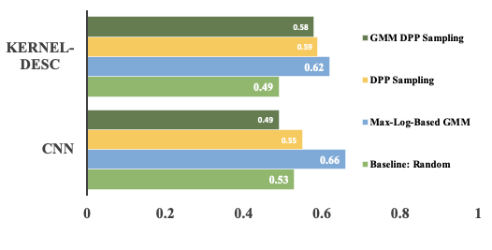
Neural Vs. Non-Neural
Neural Architecture Search Network (NasNetLarge)
  “imagenet” pretrained
DPP based and Max Log Density performs better
  Selects diverse and informative points
GMM DPP sampling
  CNN features adds complexity
Notes:
In this evaluation, we aim to answer the influence of visual features in active learning approaches. Kernel descriptors are used as the traditional visual feature extraction approach. NasNetLarge CNN with pre-trained imagenet weights is used to extract 1024 dimension features. In the picture, the light green bar is the random baseline result; the blue bar is the Pool based log density; the yellow bar is the DPP approach, and the dark green is the GMM DPP sampling result. We can see that GMM DPP sampling lacks in performance for CNN visual features. The combination of GMM and DPP could not model the representativeness from the CNN features.

Slide 17
Different Classifiers
Sampling | LR | SVM | MLP
Baseline: Random | 0.75 | 0.72 | 0.62
Max-Log-Based GMM | 0.82 | 0.66 | 0.54
DPP Sampling | 0.8 | 0.66 | 0.6
GMM DPP Sampling | 0.78 | 0.63 | 0.5
Logistic regression consistently outperforms.
Choice of classification algorithms are important.
  Consideration specific to characteristics/dataset
  Appropriate classifiers for active learning
Notes:
In the next evaluation, we are trying to find the effectiveness of different classification algorithms for the final language grounding classification task. SVM is one of the popular algorithms that is used as part of active learning systems that use supervised approaches. We also verify one hidden layer MLP (Multi-layer perceptron) along with logistic regression. Here the results show that SVM and MLP are not performing well along with our active learning approaches. This indicates the necessity of a careful selection of classification algorithms in active learning.

Slide 18
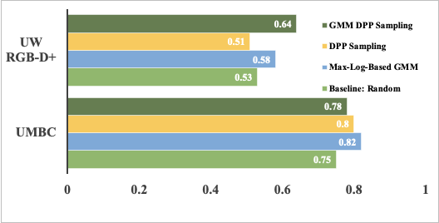
Different Datasets
UW RGB-D+ Dataset
  300 objects, 52 object types, multi-colored objects
  Highly varied color, shape, and object features
Max-Log Based GMM and GMM DPP outperforms
  Select the most informative and representative
Notes:
To check the generalizability of our AL approaches, we tested them with the UW RGB-D+ dataset. It is a 300 object dataset with multi-color objects. There are 51 unique objects, and the description for the color concepts are highly noisy. In this picture, light green shows the random baseline, and the yellow bar shows the DPP sampling. With these multi-colored, highly noisy, and varied features, DPP could not model diversity well. But the GMM-DPP and Log Based Pool sampling performed well in all cases.

Slide 19
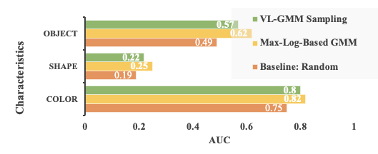
Effect of Language
Semantic representation of description
  Paragraph vectors
Selects representative points closest to the cluster centers.
Vision-Language sampling not suitable for large dataset
Notes:
Finally, we evaluated the influence of language along with vision in unsupervised clustering. We name it Vision-Language GMM sampling. Instead of using just visual features, we converted the descriptions as paragraph vectors and joined with visual features as the input to GMM clustering. Here we are comparing the vision only GMM pool based sampling and Vision-Language GMM pool based sampling. Both select the representative points, and both outperform baseline in all characteristic concept learning. But VL sampling is not suitable for large datasets as it requires the language, and annotation costs are high.

Slide 20
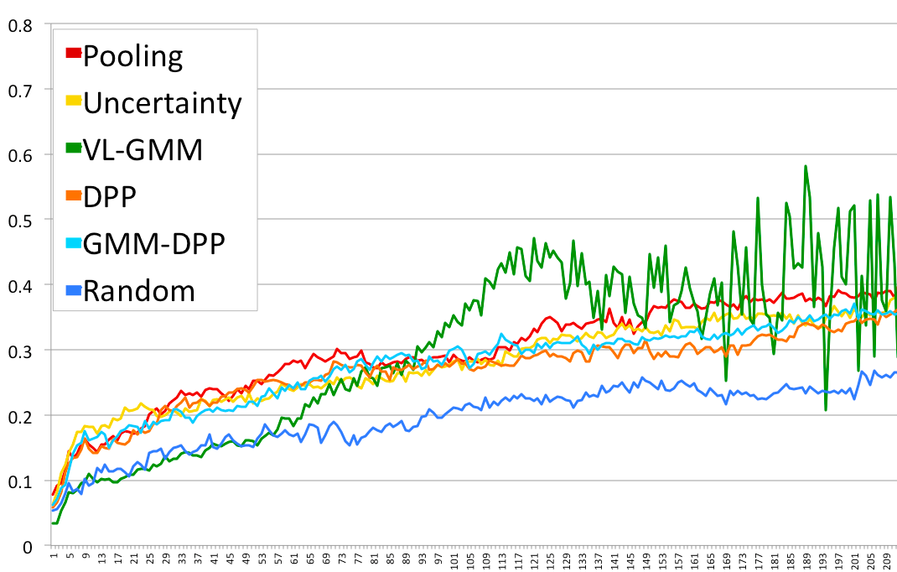
Results: Varying Datasize
Limited resources
  288 visual – language pairs
Highly varied and noisy.
AL methods select informative and diverse points
Notes:
Our last experiment was to find the effect of AL approaches with varying data sizes. Minimal data resources are utilized for that. We can see all AL approaches perform better than the baseline, which is the blue line for all data sizes.

Slide 21
Analysis
For neither visually varied nor linguistically complex
  Most representative or/and diverse data points
Visually differentiated, Linguistically complicated
  GMM with DPP finds representative and salient features
  Uncertainty sampling not strong for sparsely populated features
AL methods set the right order of data points
  Increase grounding efficiency
  Fewer training data
  Reduced annotation costs
Notes:
Detailed analysis can be seen in the paper. Here are some points. All our AL approaches that choose representative and diverse points work well for neither visually complex nor linguistically varied features. But when the data is sparsely populated, uncertainty sampling is weak. AL methods set the right order, lower the annotation costs, fewer training data, and improve learning efficiency. We can see the Max Log Density based pool sampling is performing better in all cases.

Slide 22
Contribution
Robot driven language acquisition system
Verification and quality comparison
  Analysis with various parameters
  Different datasets
  Language in combination with Vision in Sampling
More efficient than naïve corpus annotation
Notes:
Our main contributions are robot-driven grounded language systems for human-robot interaction environment—a broad exploration of active learning techniques with various parameters. And a more efficient robot language acquisition system.

Slide 23
Questions?

Slide 24
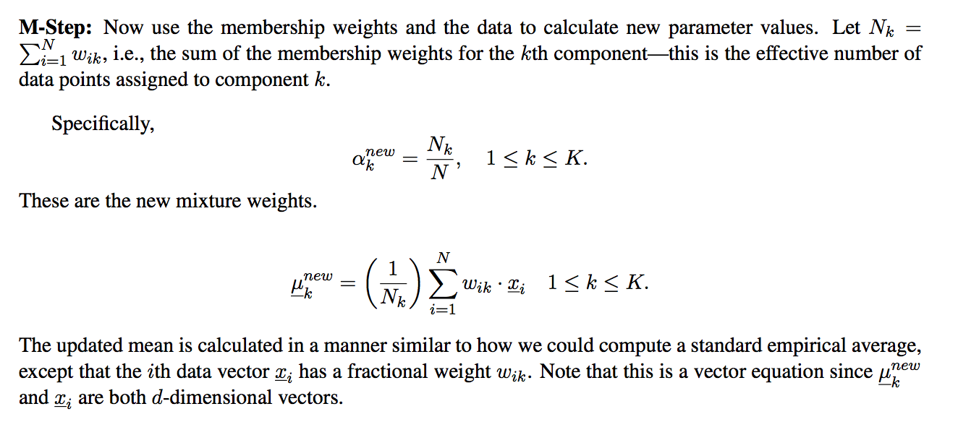
Extra slides
M-Step
    http://www.ics.uci.edu/~smyth/courses/cs274/notes/EMnotes.pdf

Slide 25
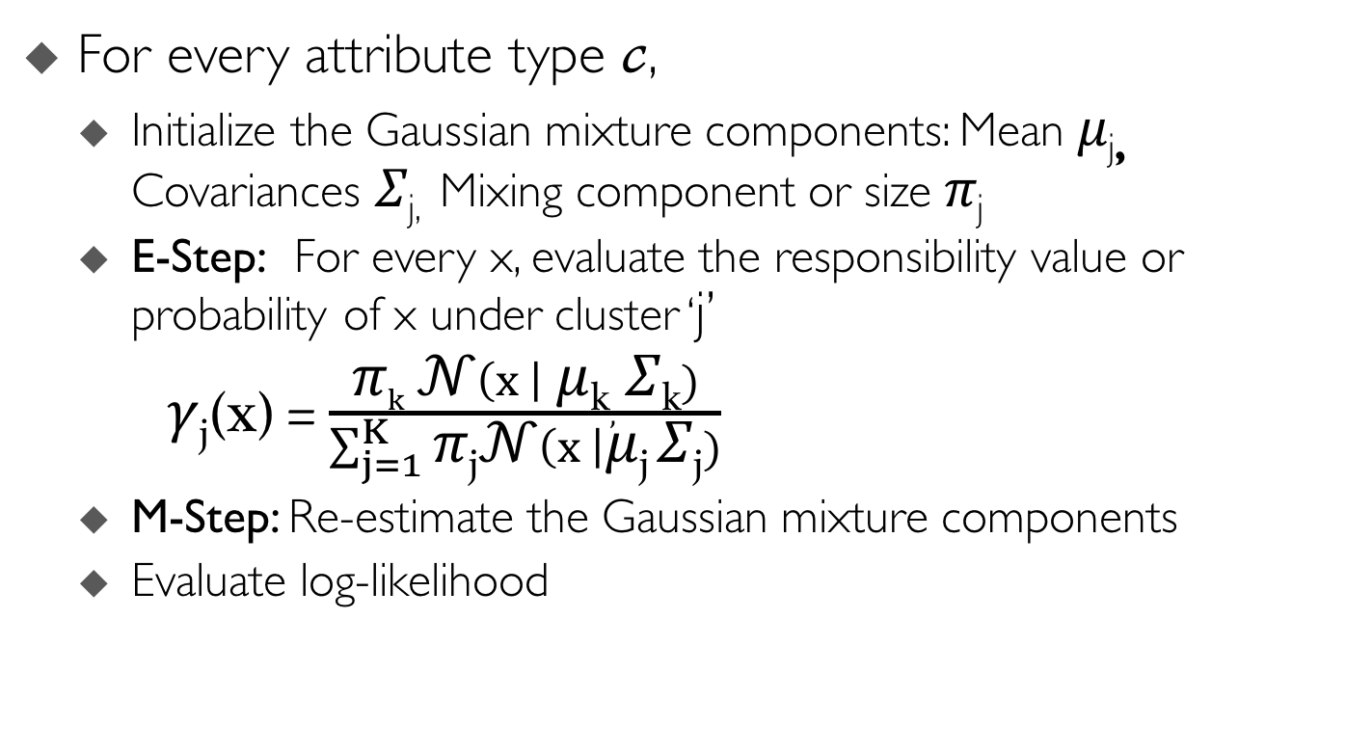
GMM with EM
Long, Chengjiang, and Gang Hua. "Multi-class multi-annotator active learning with robust gaussian process for visual recognition." Proceedings of the IEEE International Conference on Computer Vision. 2015.
Notes:
Let me give an overall idea how GMM model with EM works. For every attribute type, for example, color, shape or object type, we will have a pool of unlabeled data points.

Slide 26
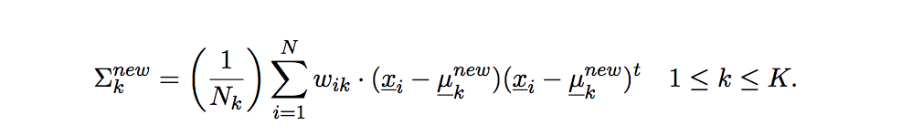
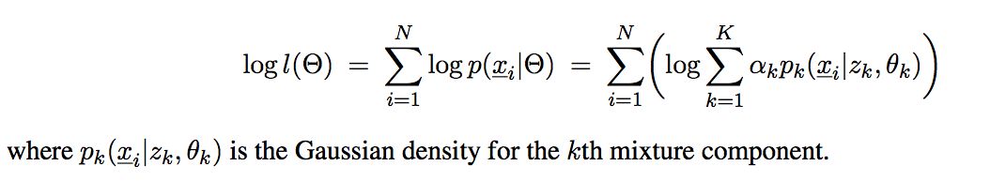
Extra Slides
Maximize log-likelihood
    http://www.ics.uci.edu/~smyth/courses/cs274/notes/EMnotes.pdf

Slide 27
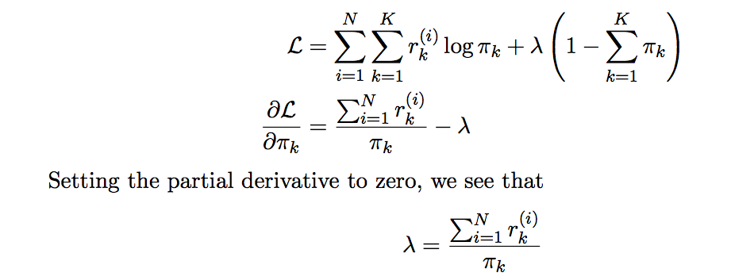
Log Likelihood
    http://www.cs.toronto.edu/~rgrosse/csc321/mixture_models.pdf

Slide 28
Limitations and alternatives
Limitation: local maxima – several iteration needed
MLE might overfit the data. Sensitive to the random variation in data.
Solution – add a regularization to it
Alternative: MAP Approximation
Regularization achieved as parameters are drawn from a random process
Prediction is influenced by prior beliefs

Slide 29
Learning What Words Mean
Proposed Work
Learn the meaning of a word from natural conversation
  Learn an association from language to perceived environment
  Visual percepts 🡨🡪 attribute words
  Joint model of visual percepts and natural language to identify novel objects, shape and color described by tokens (words)^{[2]}
    ^{[2]} Matuszek, FitzGerald, Zettlemoyer, Bo, Fox. ICML 2012.
Notes:
My proposal is robot learning language effectively and efficiently. That brings to a question. What word means to a robot? In my work, it is about learning an association between language and visual percepts. We map visual percepts with the words from the natural description. As I stated before, we use the joint model of language and vision to identify object attributes; color, shape, and object. In this research, I mainly focus on learning 3 categories of objects; color, shape, and object type.

Slide 30
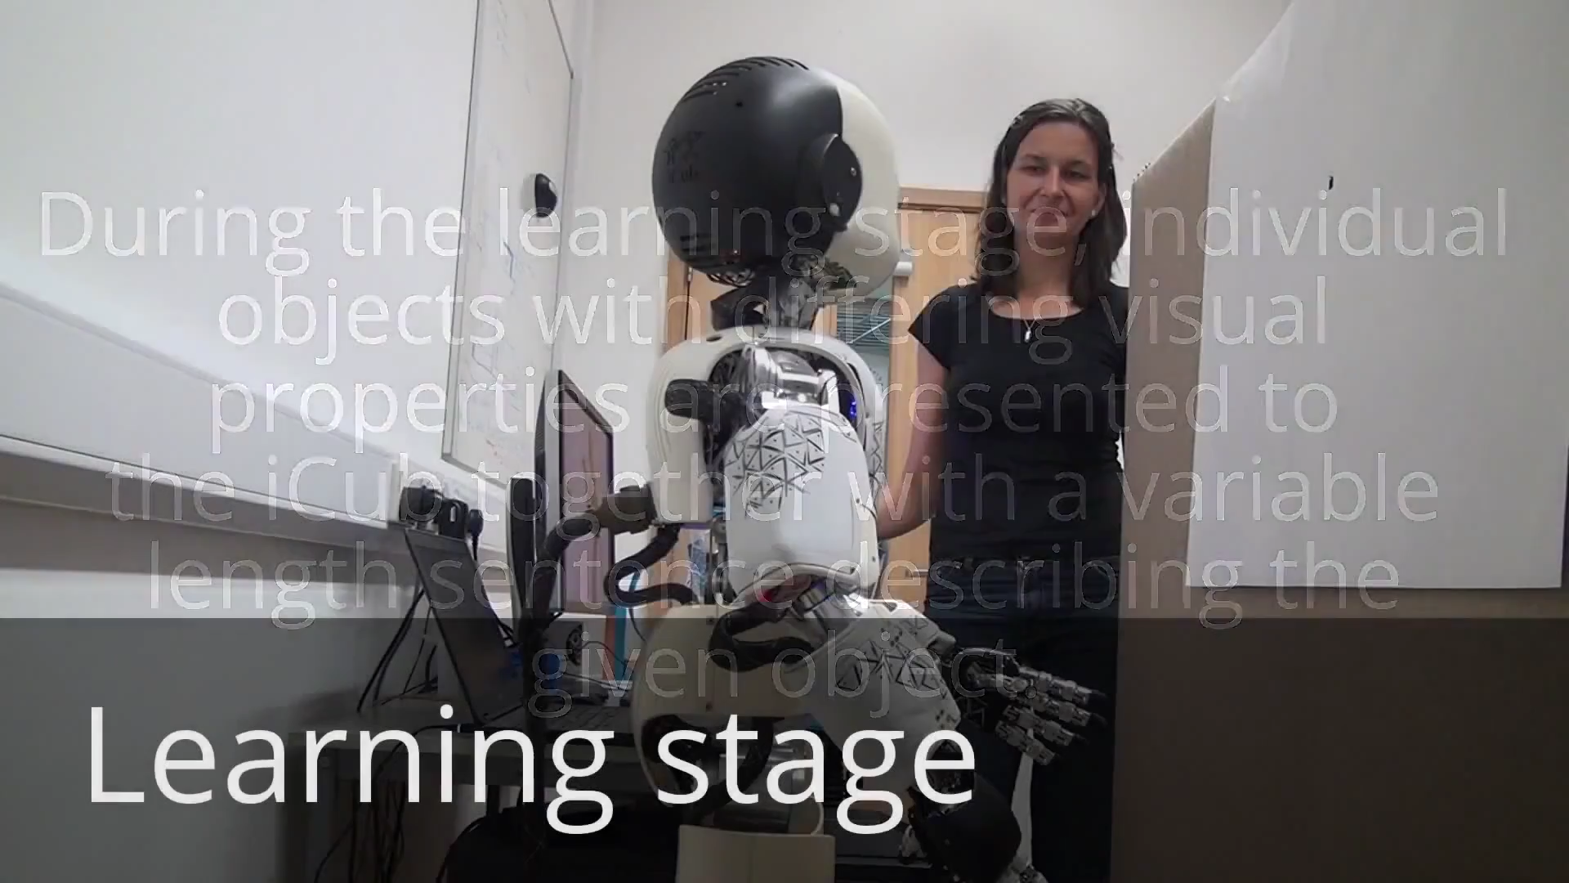
Motivation
Human driven
Repetitive
Non-engaging
Frustrating
Large number of annotations
    ^{[1]} iCub, an open source robotic platform.
Notes:
I would like to draw your attention to a robot learning system where human tries to teach the robot.
You might have noticed that this system is monotonous, not entertaining and need extensive manual supervision.

Slide 31
Feature Extraction
Color: RGB features extracted from color channel
Shape and object: using kernel descriptors from depth channel^{[2]}
  Size, 3D shape, and depth edge
  NasNetLarge, a Convolutional Neural Network
    [2] Bo, Ren, Fox. 2013

Slide 32
Probabilistic Modelling
Gaussian Mixture Model (GMM)
  Soft cluster assignment to model uncertainty
  Parametric methods for stability
Deterministic Point Process (DPP)^{[2]}
  Models diversity
  Repulsive processes
[2] Kulesza and Taskar, 2014

Slide 33
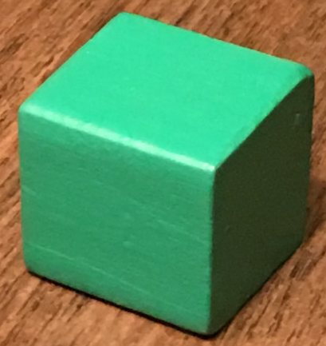
Learning Groundings
  Users describe objects the robot should understand
  When new language concepts are encountered
  Visual classifiers are created and trained on the perceptual context
  Concepts are associated with those classifiers
As more objects are seen, 'best’ classifier emerges
Language
Annotation
Perceived
world state
Newly created semantics
Concept “short”
🡨🡪
new-classifier-
called-‘short’
“This is a short green cube.”
Learning
Word “green”
🡨🡪
new-classifier-
called-‘green’
Word “cube”
🡨🡪
new-classifier-
called-‘cube’
Notes:
Our learning system utilizes natural description from humans to learn the language. Users describe the objects that robot should understand
In this example, the user describes the object as "short green cube". So we create visual classifiers by mapping the words "short" or "green" or "cube" with the visual features of the object.
We try to learn 3 attribute type. Color, shape and object in this research.

Slide 34
Architecture
Visual Features: color, shape, and object features segmented from depth channel
Query: Request description
Response: Noisy description
Interpreter: Extract tokens
Learning System: Train on all objects labeled with tokens
Notes:
Here is the overall architecture of our system, where the robot has no prior knowledge. Its job is to learn the semantic representation of the real-world objects it interacts with. The robot uses the visual feature extraction approaches and ranks the objects based on their informativeness or diversity. Then the robot seeks the help of a human it meets to know the description of the selected objects. The description is passed on to the language interpreter, and then the robot learning system associates the interpreted concepts with the visual features of the objects.

